Slide 1
Lecture 1: Vision Based Automation
Introduction

Slide 2
Book References
A.K. Jain: Fundamentals of Digital Image Processing, Prentice Hall,1989
E. Trucco and A. Verri: Introductory Techniques for 3-D Computer Vision
R.C. Gonzalez and R.E. Woods: Digital Image Processing,
Prentice-Hall, 2002
David A. Forsyth and Jean Ponce: Computer vision: a modern approach. Prentice Hall, 2002.
Bernd Jähne: Digital image processing, Springer-Verlag Berlin Heidelberg 2001

Slide 3
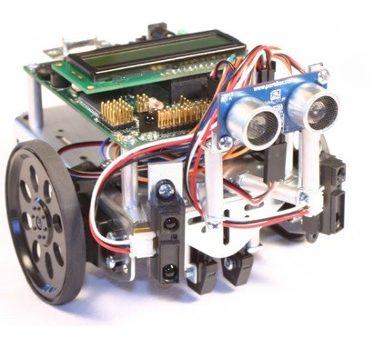
Vision Based Automation
#5
Deals with the formation, analysis and Interpretation Images
Is an integral part of Artificial Intelligence (AI)
Is interdisciplinary subject area
Is Practical and useful
Is modern, challenging and continuously evolving

Slide 4
Difficulties
Images are ambiguous : Projective
Images are affected by many factors
Sensor model
Illumination
Shape of object(s)
Color of object(s)
Texture of object(s)
There is no “Universal Solution” to the Vision problem
There are many theories
We do not understand how the human Visual System works
Computer technology changes continuously, Hence Computer Vision is evolving.

Slide 5
Why is Vision Based automation Difficult?
It is a many-to-one mapping
A variety of surfaces with different material and geometrical properties, possibly under different lighting conditions, could lead to identical images
Inverse mapping is under-constrained – non-unique solution (a lot of information is lost in the transformation from the 3D world to the 2D image)
It is computationally intensive
We still do not understand the recognition problem

Slide 6
Nomenclature
Somewhat interchangeable names, with somewhat different implications:
Computer Vision
Most general term
Computational Vision
Includes modeling of biological vision
Image Understanding or Scene Understanding
Automated scene analysis (e.g., satellite images, robot navigation)
Machine Vision
Industrial, factory-floor systems for inspection, measurements, part placement, etc.

Slide 7
Related Fields
Largely built upon
Image Processing
Statistical Pattern Recognition, Machine Learning
Artificial Intelligence
Related areas
Robotics
Biological vision
Medical imaging
Computer graphics
Human-computer interaction

Slide 8
Brief History
B.C. (Before Computers)
Philosophy
Optics
Psychophysics
Neurophysiology
Psychophysics and neurophysiology describe the behavior of cells or subjects, but do not explain such behavior
Black box – how can we figure it out?

Slide 9
Progress in Computer Vision
First generation: Military/Early Research
Few systems, each custom-built, cost $Ms
“Users” have PhDs
1 hour per frame
Second generation: Industrial/Medical
Numerous systems, 1000s of each, cost $10Ks
Users have college degree
Special hardware
Third generation: Consumer
– 100000(00) systems, cost $100s
Users have little or no training
Emphasis on software

Slide 10
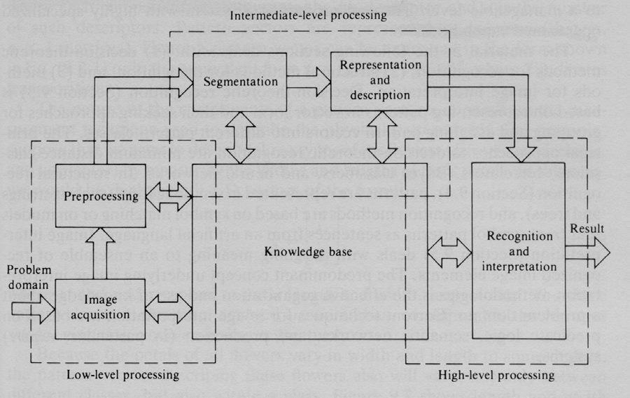
The Three Processing Levels
Low-level processing
Standard procedures are applied to improve image quality
No “intelligent” capabilities

Slide 11
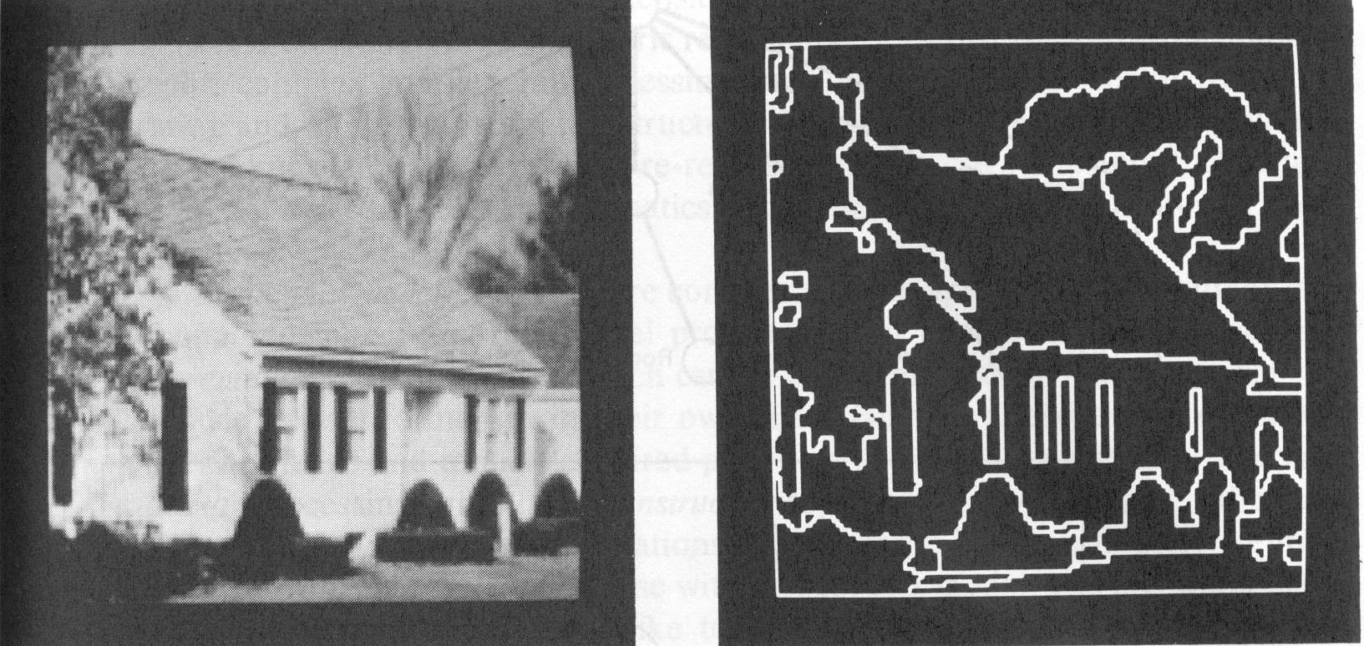
The Three Processing Levels
Intermediate-level processing
Extract and characterize components in the image
Some intelligent capabilities are required

Slide 12
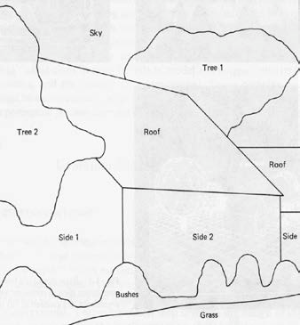
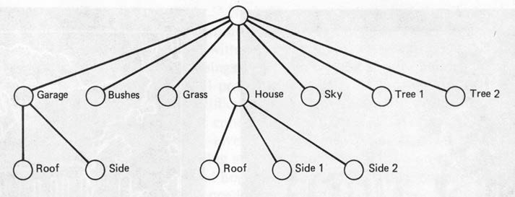
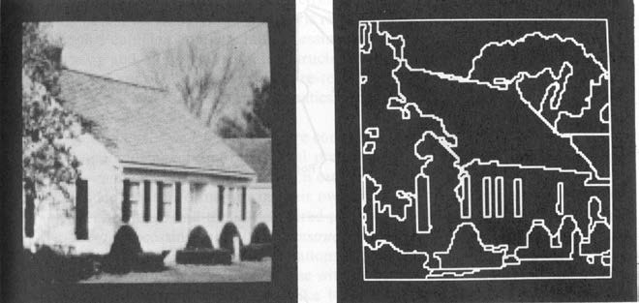
The Three Processing Levels
High-level processing
Recognition and interpretation
Procedures require high intelligent capabilities

Slide 13
Applications
– Robotics
Navigation, object manipulation, interaction with humans…
Inspection, measurement
Medical imaging
Graphics and animation, special effects
Multimedia database indexing and retrieval
Human-computer interaction
Surveillance and security
Face and Iris Recognition

Slide 14


Computer Vision
Output:
Model
Real Scene
Cameras
Images

Slide 15

Computer Graphics
Projection, shading, lighting models
Output:
Image
Model
Synthetic Camera

Slide 16
Another View
Interesting
Computational vision
Computer vision
Machine vision
Actually works

Slide 17
Why study Vision Based Automation?
Interpretation of Visual Information
Images and movies are everywhere
Mobile phone, cheaper cameras enabling the imaging capture
Fast-growing collection of useful applications
Face finding, recognition, analysis
building representations of the 3D world from pictures
automated surveillance (who’s doing what)
movie post-processing
Various deep and attractive scientific mysteries
how does object recognition work?
Greater understanding of human vision

Slide 18
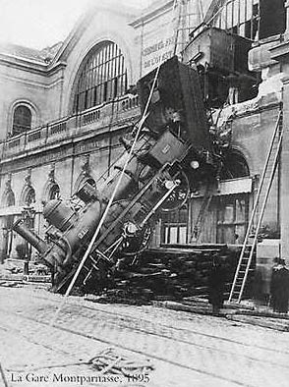
Every picture tells a story
Goal of vision based automation is to enable machines analyze and interpret images

Slide 19
Part I: The Physics of Imaging
How images are formed
Cameras
How a camera creates an image
How to tell where the camera was
Light
How to measure light
What light does at surfaces
How the brightness values we see in cameras are determined
Color
The underlying mechanisms of color
How to describe it and measure it

Slide 20
Part II: Early Vision in One Image
Representing small patches of image
For three reasons
We wish to establish correspondence between (say) points in different images, so we need to describe the neighborhood of the points
Sharp changes are important in practice --- known as “edges”
Representing texture by giving some statistics of the different kinds of small patch present in the texture.
Tigers have lots of bars, few spots
Leopards are the other way

Slide 21
Representing an image patch
Filter outputs
essentially form a dot-product between a pattern and an image, while shifting the pattern across the image
strong response -> image locally looks like the pattern
e.g. derivatives measured by filtering with a kernel that looks like a big derivative (bright bar next to dark bar)

Slide 22
Texture
Many objects are distinguished by their texture
Tigers, cheetahs, grass, trees
We represent texture with statistics of filter outputs
For tigers, bar filters at a coarse scale respond strongly
For cheetahs, spots at the same scale
For grass, long narrow bars
For the leaves of trees, extended spots
Objects with different textures can be segmented
The variation in textures is a cue to shape

Slide 23
Part III: Early Vision in Multiple Images
The geometry of multiple views
Where could it appear in camera 2 (3, etc.) given it was here in 1 (1 and 2, etc.)?
Stereopsis
What we know about the world from having 2 eyes
Structure from motion
What we know about the world from having many eyes
or, more commonly, our eyes moving.

Slide 24
Part IV: Mid-Level Vision
Finding coherent structure so as to break the image or movie into big units
Segmentation:
Breaking images and videos into useful pieces
E.g. finding image components that are coherent in internal appearance
Tracking:
Keeping track of a moving object through a long sequence of views

Slide 25
Part V: High Level Vision (Geometry)
The relations between object geometry and image geometry
Model based vision
find the position and orientation of known objects
Smooth surfaces and outlines
how the outline of a curved object is formed, and what it looks like
Aspect graphs
how the outline of a curved object moves around as you view it from different directions
Range data

Slide 26
Part VI: High Level Vision (Probabilistic)
Using classifiers and probability to match and recognize objects
Templates and classifiers
how to find objects that look the same from view to view with a classifier
Relations
break up objects into big, simple parts, find the parts with a classifier, and then reason about the relationships between the parts to find the object.
Geometric templates from spatial relations
extend this trick so that templates are formed from relations between much smaller parts

Slide 27
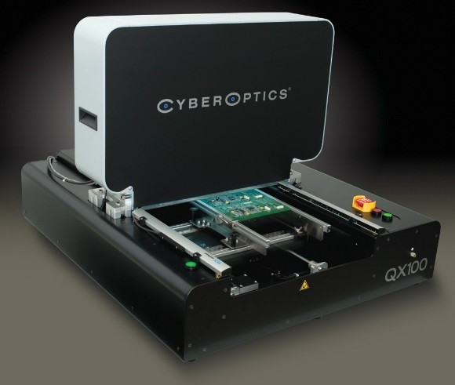
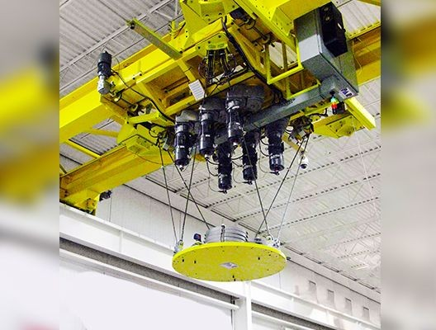


Examples of Commercial Vision Systems
High Precision Inspection System
Par Systems: Vision Guided Robotics for manufacturing and assembly lines
There are many products that have an element of computer vision, and the number is increasing every day
NASA Rover

Slide 28
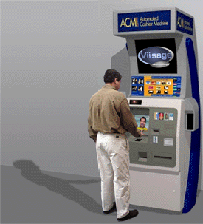
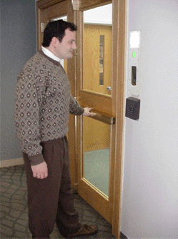
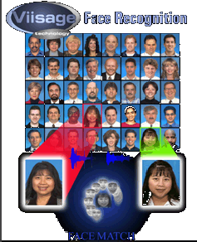
Security Applications
Face Recognition:
Face Detection
Face Labeling
Face Finding
Can you Name any Company Using Face Applications ?

Slide 29
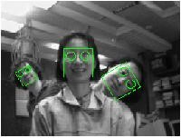
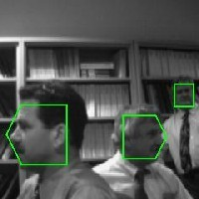
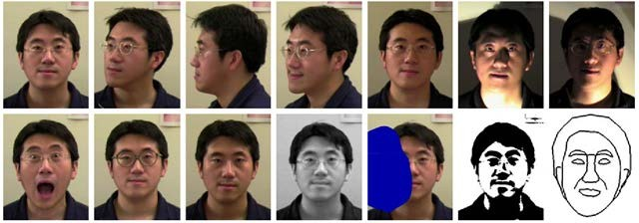
Face Detection
Challenges: Pose and Illumination variations

Slide 30
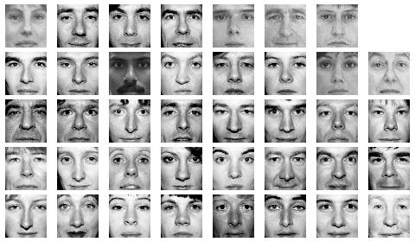
Face Recognition

Slide 31
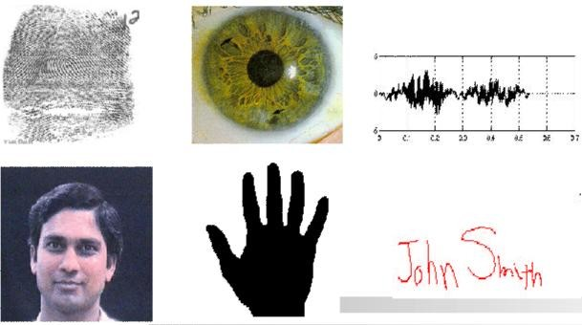
Multi Biometrics

Slide 32
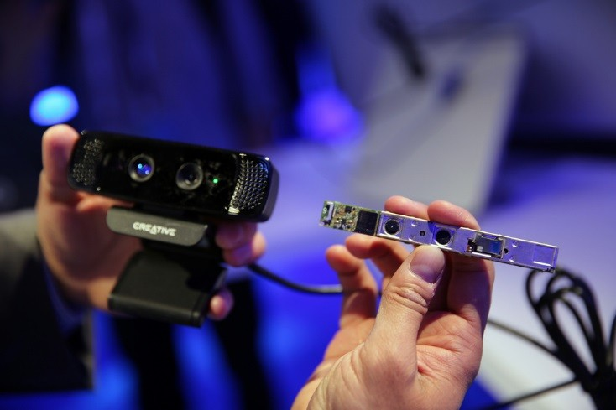

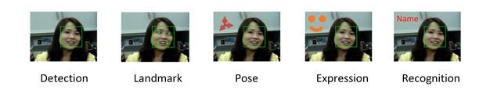
Vision-Based Interfaces
Intel and Microsoft New 3D Sensors
Gesture Recognition
3D Face Analysis and Recognition

Slide 33
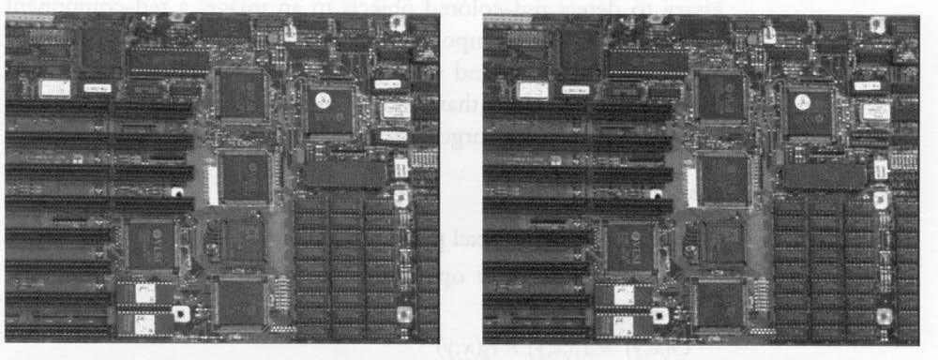

Visual Inspection

Slide 34
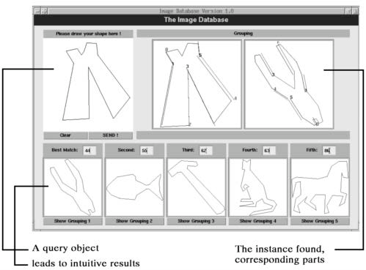
Indexing into Databases
Shape content

Slide 35
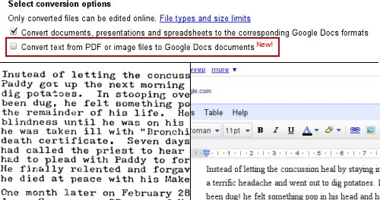
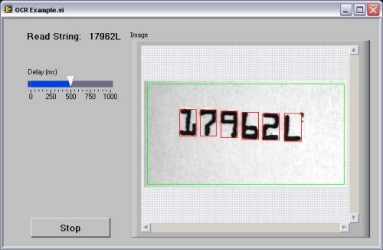
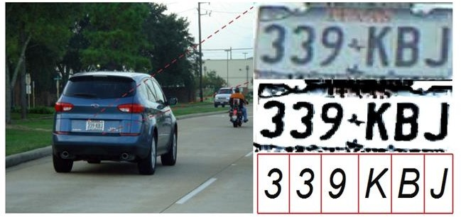
Application: Optical Character Recognition
#42
License Plate Recognition

Slide 36
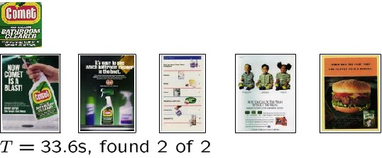
Indexing into Databases
Color, texture

Slide 37
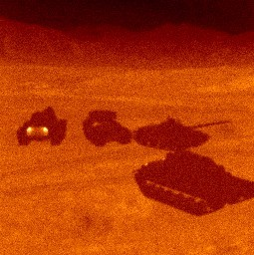
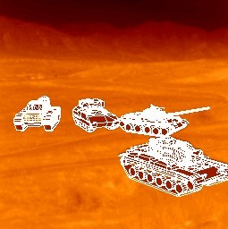
Target Recognition
Department of Defense (Army, Airforce, Navy)

Slide 38
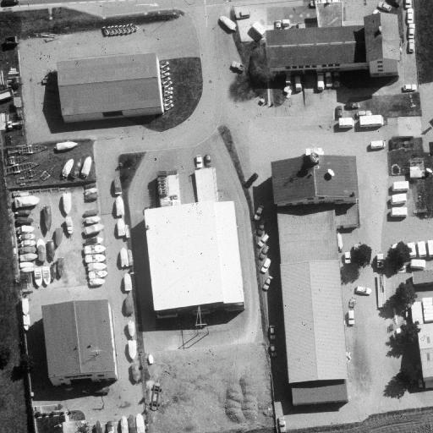
Interpretation of Aerial Photography

Slide 39
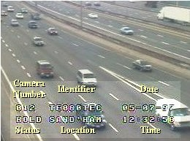
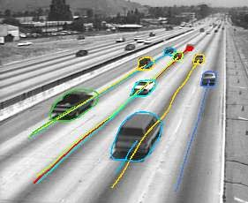
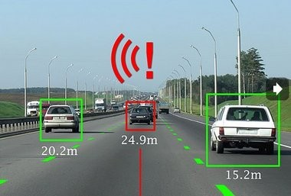
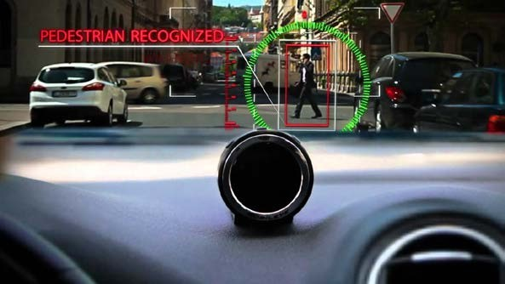
Traffic Monitoring

Slide 40
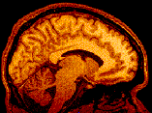
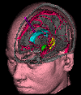
Brain Imaging

Slide 41
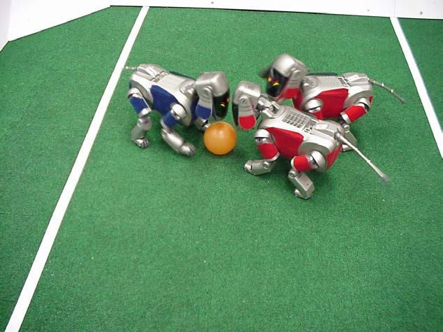
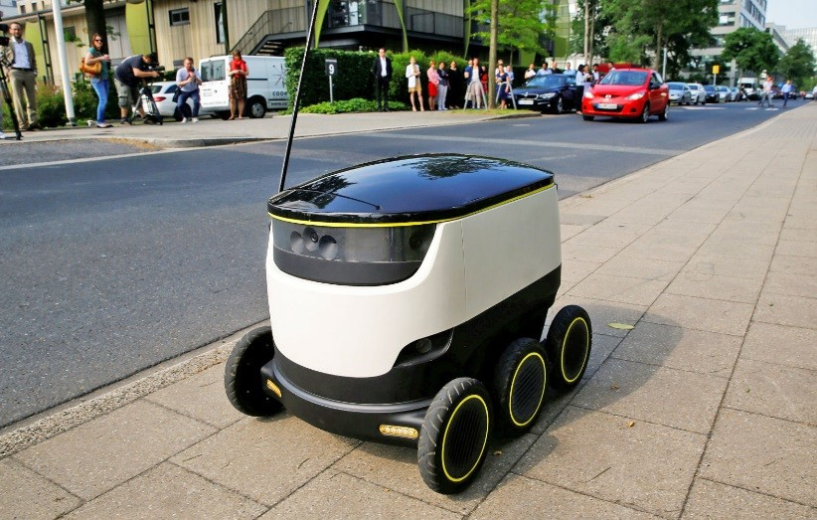
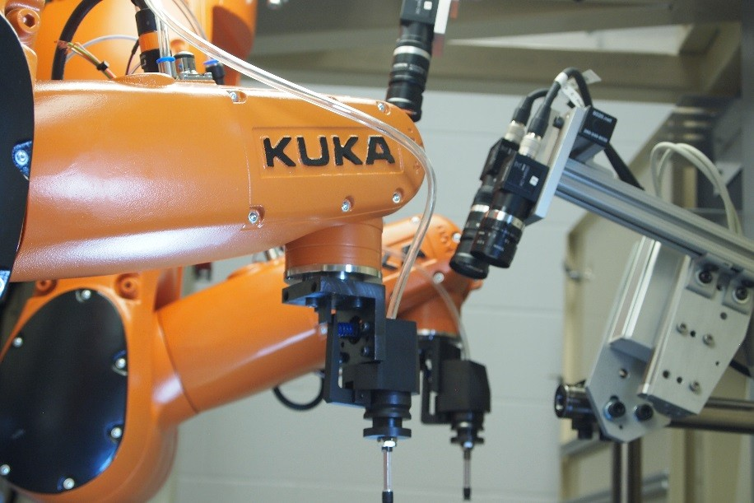
Applications: Robotics

Slide 42
Types of images
infra-red
ultra-violet
radio-waves (radio astronomy)
visible light
micro-waves (radar)
roentgen (tomography)
sound-waves (echoscopy, sonar)
electrons (microscopy)
positron emission (PET-scan)
magnetic resonance (NMR)

Slide 43
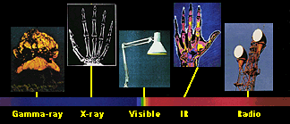
Electromagnetic (EM) Spectrum

Slide 44
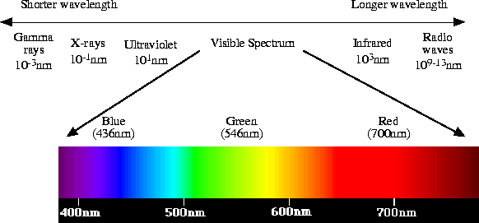
Electromagnetic (EM) Spectrum

Slide 45
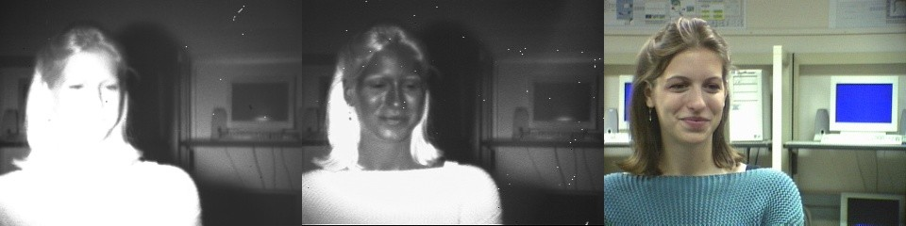
Imaging in Different Wavelengths

Slide 46
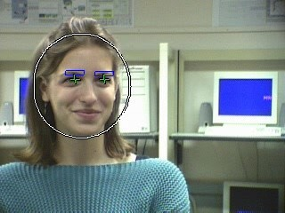
Face and Face Feature Localization

Slide 47
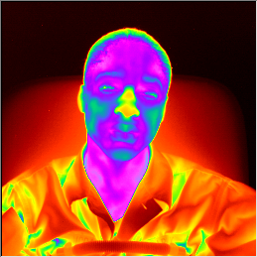
Thermal Imaging

Slide 48
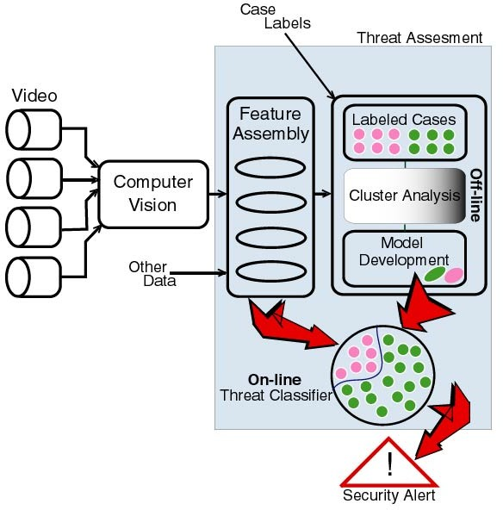
Video Analytics Security Architecture

Slide 49
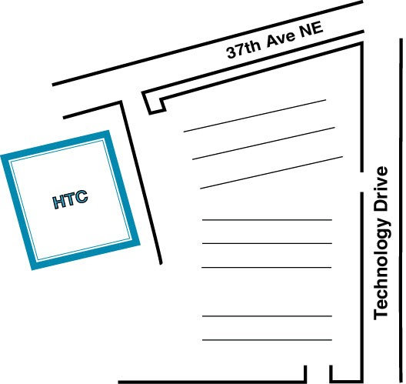
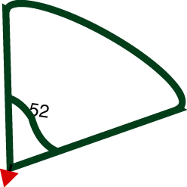
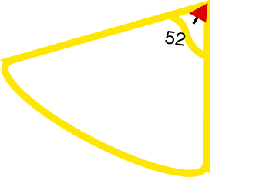
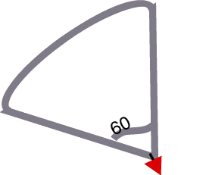
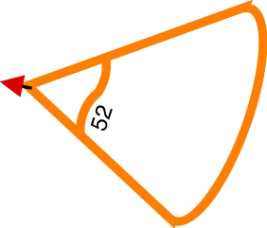
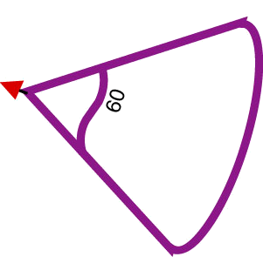
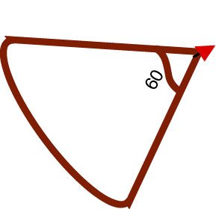

Camera Network Physical Design
color cameras
medium resolution
smaller Field of Views
camera symbol
60
Field of View symbol

Slide 50

Statistical Modeling of Image Pixels

Slide 51

Continuous Learning of Foreground/Background pair

Slide 52

Outdoor Motion Detection

Slide 53




Video Surveillance: Tracking

Slide 54

Video Surveillance: Tracking

Slide 55

Human Tracking and Pan/Tilt Control

Slide 56

Video Tracking: Multiple PTZCameras

Slide 57

People Detection and Tracking

Slide 58

Human Activity Recognition

Slide 59






Effective Command & Control
Security Today:
✗ Coverage areas are enormous
✗ Too many images - it is difficult to interpret activities

Slide 60

Command & Control
✗ Integrate hundreds of sensors in a unified view
✗ Move seamlessly in space - god’s eye view to up close
✗ Move seamlessly in time - replay and rehearse
✗ Alert operators to key events
✗ ID individuals
✗ Track and overlay
✗ Record, compress and store
✗ Archive and data mine

Slide 61

Next Generation Browser “Fly-Through” with Real-Time Video
Project video on a graphics model – with ability to render from any view

Slide 62



3D Tracking and Registration

Slide 63
Can computers match human perception?
Not yet
computer vision is still no match for human perception
but catching up, particularly in certain areas

Slide 64





Autonomous Vehicles
Land, Underwater, Space

Slide 65

Autonomous Navigation
Auto X

Slide 66
Conclusion
Vision Based Automation is an exciting and challenging field
Applied in many real world solutions
Tremendous progress in the last decades
Still have long way to go …

Slide 67
Companies In this Field In India
Sarnoff Corporation
Kritikal Solutions
National Instruments
GE Laboratories
Ittiam, Bangalore
Interra Systems, Noida
Yahoo India (Multimedia Searching)
nVidia Graphics, Pune
Microsoft research
DRDO labs
ISRO labs

